Slide 1


Strengths and Weaknesses in Identification Methods for Learning Disabilities: Is Cognitive Assessment Necessary?
Learning for SUCCESS
www.texasldcenter.org
Jack M. Fletcher, Ph.D.
Department of Psychology
University of Houston
jack.fletcher@times.uh.edu
The Texas Center for
Learning Disabilities
(TCLD) investigates
the classification, early intervention, and
remediation of learning disabilities.

Slide 2
Disclosures
1. Author of Texas Primary Reading Inventory (Paul F. Brookes)
2. Author of Learning Disabilities: From Identification to Intervention (Guilford Press)
3. Research supported by NICHD grant, P50 HD052117, Texas Center for Learning Disabilities (www.texasldcenter.org)
4. Presentation not intentionally aligned with any standards. I am a neuropsychologist and scientist
5. Father of two grown (?) children

Slide 3
Objectives
1. Understand research on identification methods for LD
2. Appreciate research on the role of cognitive assessments for identification and intervention
3. Understand methods for identification and intervention based on response to instruction

Slide 4
What are Learning Disabilities ?
(how do I know one when I see one?)
All disabilities have biological and social realities that vary with “disorder” and “person”
Learning disabilities are dimensional- variation on normal development
Model is obesity or hypertension, not measles and mumps
“Disability” is a two pronged determination

Slide 5
Learning Disabilities is a Hypothetical Construct
Essential aspect of construct is “unexpected underachievement”
Constructs do not exist independently of how they are measured; all measures are imperfect indicators of constructs (latent variables)
Measurement depends on definition
Definitions and identification criteria derive from classifications
Classifications reflect conceptual models

Slide 6
How LD is Identified and Treated Depends on the Conceptual Model
Neurological: “Disorder of constitutional origin”’: special signs
Cognitive Discrepancy:
  IQ-achievement discrepancy: cognitive discrepancy
  Processing strengths and weaknesses: cognitive discrepancy
Instructional Discrepancy
  Low achievement: age-based discrepancy
  Instructional response: intractability

Slide 7
Federal Definition of LD (1968)
The term “specific learning disability” means a disorder in one or more of the basic psychological processes involved in understanding or in using language, spoken or written, which may manifest itself in an imperfect ability to listen, speak, read, write, spell, or to do mathematical calculations. The term includes such conditions as perceptual handicaps, brain injury, minimal brain dysfunction, dyslexia, and developmental aphasia. The term does not include children who have learning disabilities which are primarily the result of visual, hearing, or motor handicaps, or mental retardation, or emotional disturbance, or of environmental, cultural, or economic disadvantage (USOE, 1968).

Slide 8
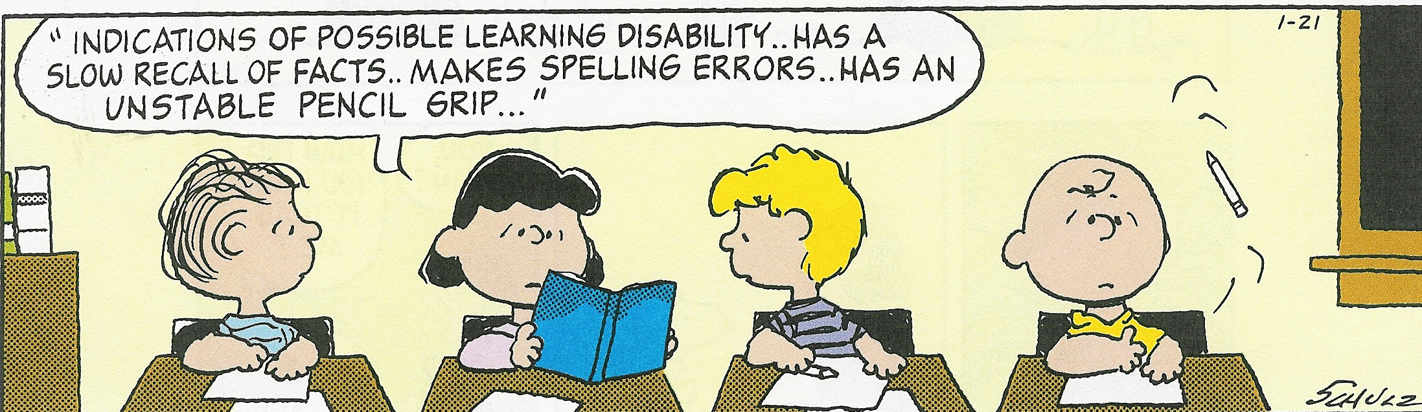
FROM “PEANUTS”
Is Charlie Brown LD? 1968 View of LD
What are the signs of LD? Identify a static, neurobiological disorder in order to intervene
Notes:
8
Measure his IQ and look for minor signs of brain dysfunction

Slide 9
LD is a Valid Classification
Learning disabilities are real! Stands up across definitional variation (doesn’t help identify individuals)
Children and adults with different forms of LD can be reliably and validly differentiated from each other, typical achievers, and other disabilities on cognitive correlates, response to intervention, and neural correlates
What happens when we apply these criteria to different classifications?

Slide 11
Federal Regulatory Definition of LD (1977) Was Not Aligned with Research
A severe discrepancy between achievement and intellectual ability in one or more of the areas: (1) oral expression; (2) listening comprehension; (3) written expression; (4) basic reading skill; (5) reading comprehension; (6) mathematics calculation; or (7) mathematic reasoning. The child may not be identified as having a specific learning disability if the discrepancy between ability and achievement is primarily the result of: (1) a visual, hearing, or motor handicap; (2) mental retardation; (3) emotional disturbance; or (4) environmental, cultural, or economic disadvantage (USOE, 1977).

Slide 12
What’s Wrong With IQ- Discrepancy?
IQ- discrepant and non- discrepant low achievers do not differ significantly in behavior, achievement, cognitive skills, response to instruction, and neurobiological correlates once definitional variability accounted (Siegel, 1992; Stuebing et al., 2002).
IQ does not predict intervention response (Stuebing et al., 2009).
No difference in brain activation profiles (Tanaka et al., 2011; Simos et al., 2014)
Status methods for identification may not be reliable based on a single assessment or cutpoint (Macmann et al., 1985; 1989; 1997; Francis et al., 2005)

Slide 13
IQ-Discrepant
Age Adjusted Standardized Score
Low
Achievement

Slide 14
Low Achievement method does not address unexpectedness
Designate a cut point on the achievement dimension
Strengths: Strong validity, linked to intervention, easy to implement
Weaknesses: Cut point, does not measure the underlying construct (can’t differentiate subgroups of poor readers when the cause is known to be related to emotional difficulty, economic disadvantage, and inadequate instruction)
Necessary but not sufficient: Status models based on cutpoints for dimensional disorders may never be reliable for individuals

Slide 15
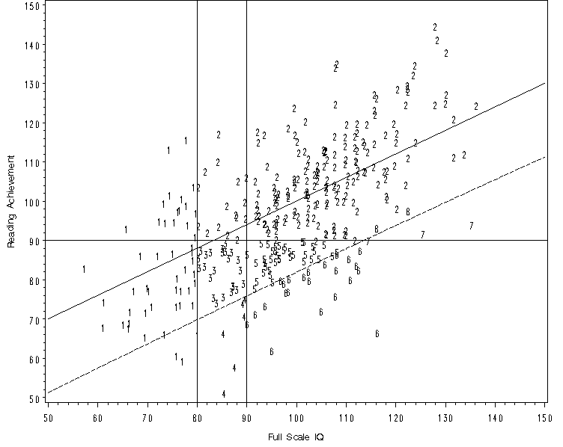

Slide 16
Alternative Views: The “Third Method”
Evaluate strengths and weaknesses in cognitive processes for inadequate responders to determine best Tx (ATI framework)
Multiple “research-based” methods based on cognitive and achievement batteries:
Ability-Achievement Consistency (Flanagan); Concordance-Discordance (Hale); Discrepancy/Consistency (Naglieri)
Hanson et al. (2008): “Research-based methods” recommended for Oregon schools
Hale et al. (2010) survey of LD professionals: PSW methods needed not just for diagnosis, but also for treatment; mandated by statute

Slide 17
Problems with PSW Approaches
Statute does not mandate that cognitive skills be assessed- just their manifestations
Little research on how PSW methods actually work and are related to instruction
Predicated on a straw person view of RTI (no standalone RTI identification method, comprehensive evaluation always required)
Psychometric issues with discrepancy scores of any kind are well known, especially the use of rigid cut points, profile interpretations, difference scores, etc.

Slide 18
Simulation of PSW Methods (Stuebing et al., SPR, 2012)
Created data sets where status of child as LD or not known; asked how well 3 PSW methods captured latent data at multiple differences
For all 3, number of children identified as LD low (about 2-3% depending on size of discrepancy)
Specificity was generally higher than .85 and NPV was uniformly above .90. Sensitivity varied from poor (.17) to excellent (.91) across conditions and PPV was usually very low and never better than moderate
For “not LD,” highly accurate (high specificity and few false negatives), but low PPV

Slide 19
Of 10,000 assessments:
CDM: 1,558 identified as LD (8,436 as not LD); 25 correct, so 1,533 are false positives and get the wrong treatment
DCM: 362 identified as LD (9,638 not LD); 89 correct, so 273 are false positives and get the wrong treatment
XBA: 678 would be identified as LD (9,322 not LD); 353 correct, 325 are false positives and get the wrong treatment
Misinterpretation of significance tests; need to account for the test correlations; preoccupation with Type I error at the cost of significant risk for Type II errors; arbitrary cut points for discrepancy and low achievement

Slide 20
Agreement on LD identification between the C/DM and XBA methods at different low achievement cut points (Miciak et al., 2013)
 | Approach
Approach | C/DM < 85 | C/DM < 90 | XBA < 85 | XBA < 90
C/DM < 85 | - | 62.1 | 30.0 | 13.6
C/DM < 90 | 0.63 | - | 20.0 | 20.5
XBA < 85 | 0.31 | 0.11 | - | 23.4
XBA < 90 | -0.04 | 0.03 | 0.22 | -
Below diagonal = kappa; above diagonal = percentage overlap (total identified by both approaches/ total identified).

Slide 21
Miciak et l., 2014
What is the level of agreement achieved by two comparable, but different assessment batteries utilized for LD identification within the C/DM? (word ID, Fluency, Comprehension)
2. What is the level of agreement achieved by the two assessment batteries on the academic domain of eligibility for LD?

Slide 22
Two Batteries Varying in Achievement tests
Reading Domain | Assessment Battery 1 |  | Assessment Battery 2
Basic Reading | WJ3 Letter/Word ID |  | WJ3 Word Attack |  | CTOPP Phonological Awareness
Reading Fluency | TOWRE Phonemic Decoding |  | TOWRE Sight Words |  | CTOPP Rapid Letter Naming
Reading Comprehension | WJ3 Passage Comp |  | Gates MacGinitie Passage Comp |  | KBIT-2 Verbal Knowledge

Slide 23
Results (cut point < 90): Poor Agreement
Kappa = .28
Percent agreement = 65%;
Percent positive agreement = 62%
Percent negative agreement = 67%
Also little overlap in the achievement domain identified as most impaired

Slide 24
Fletcher et al., SPR, 2011
Evaluate cognitive characteristics of inadequate responders to Grade 1 Tier 2 intervention
Evaluate whether different outcomes measures yield subgroups that vary in cognitive characteristics (decoding vs. fluency)
Determine if there is unique or qualitative variability in cognitive skills not attributed to level of reading ability that would necessitate cognitive ability assessment

Slide 25
Criteria for Inadequate Response
Norm Referenced Assessments of untimed word reading (WJIII Basic Reading) and timed word reading fluency <= 25th %tile
CBM measure of passage reading fluency <= 20 wcpm based on DIBELS end Grade 1 benchmarks (Continuous Monitoring of Early Reading Skills; CMERS)

Slide 26
Resultant Groups
Decoding/Fluency (n = 29)
Fluency (n = 75)
Responders (n = 85)
Typicals (n = 69)
Assessed phonological awareness (CTOPP), rapid naming (CTOPP), speed of processing (Underlining), listening comprehension (CELF), syntactic comprehension/working memory (CELF), vocabulary/verbal reasoning (KBIT Verbal), and nonverbal problem solving (KBIT Matrices)

Slide 27
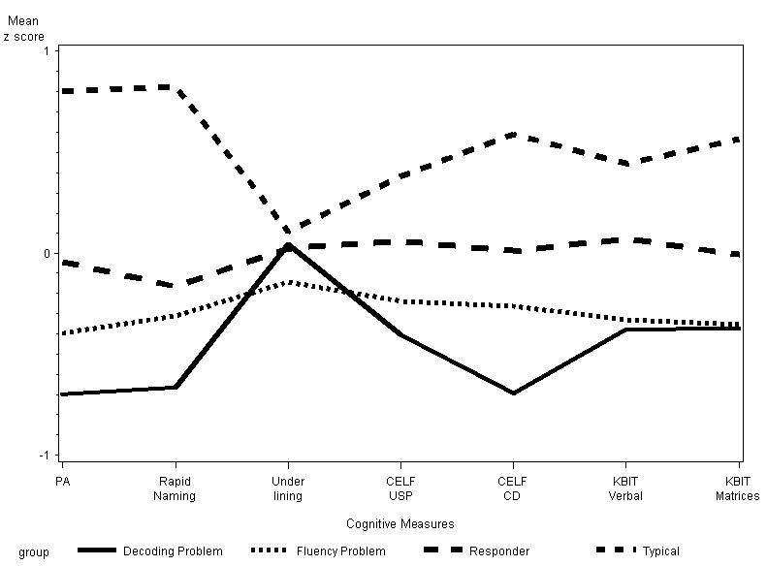
Cognitive Profiles of Inadequate Responders

Slide 28
What do cognitive assessments add?
Processing subtypes weakly related to intervention outcomes; little evidence that knowledge of cognitive strengths and weaknesses facilitates intervention (Pashler et al., 2010)
No additional information not found in achievement profiles
Cognitive deficits DO NOT reliably indicate biological causation; LD is an interaction of biological and environmental factors
IQ when there is an issue about intellectual disability, autism spectrum disorder, or other disorder where IQ is directly relevant

Slide 29
New Alternatives: Response to Instruction (Intervention)
Universal screening and serial curriculum- based assessments of learning in relation to instruction
As one criterion, student may be LD if they do not respond to instruction that works with most students (i.e., unexpected underachievement)
May identify a unique subgroup of underachievers that reflects an underlying classification that can be validated (Al- Otaiba & Fuchs, 2002; Vellutino et al., 2003)
School-wide change- not just enhanced pre-referral services and not an identification method by itself

Slide 30
Misconceptions of RTI
Goal of RTI is to identify students as LD (RTI is a service delivery framework and identification is a by product of the process)
Inadequate instructional response equates to special education eligibility (Instructional response is just one criterion for LD)
Evaluation procedures fundamentally different (a comprehensive evaluation is required and most components of evaluation/eligibility are universal)
What you do before a cognitive assessment…

Slide 31
LD Summit: Hybrid Method (Triangle Approach) to Identification (Bradley et al., 2002)
1. Establish Low Achievement
2. Evaluate Response to Instruction (Is underachievement expected?)
3. Apply the Exclusions
What is the validity of this hypothetical classification? (Low achievement is necessary, but not sufficient).
www.air.org/ldsummit

Slide 32
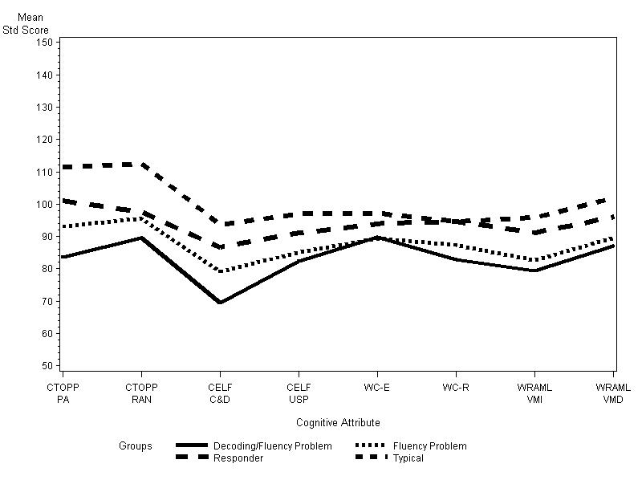
Validity of the hybrid method(Fletcher et al., SPR, 2011)

Slide 33
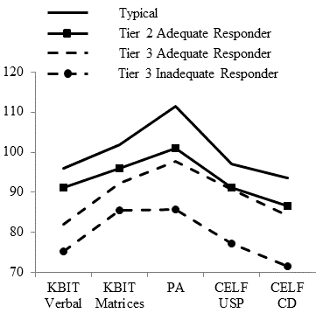
Inadequate Responders: Tier 3
(baseline cognitive characteristics)

Slide 34
Adolescents: Tier 2 Cognitive Attributes

Slide 35
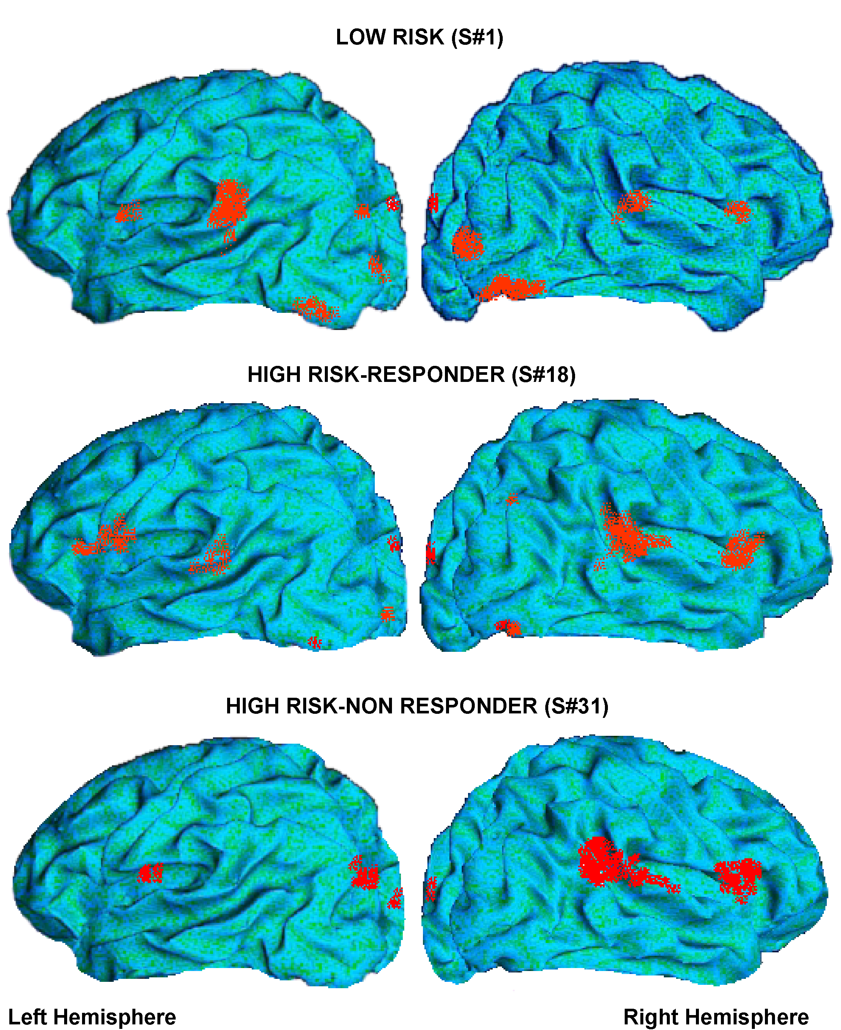
Grade 1 Intervention (pseudoword task)
Simos et al (Neuropsychology, 2005)- after Grade 1 intervention in Mathes et al. (RRQ, 2005)

Slide 36
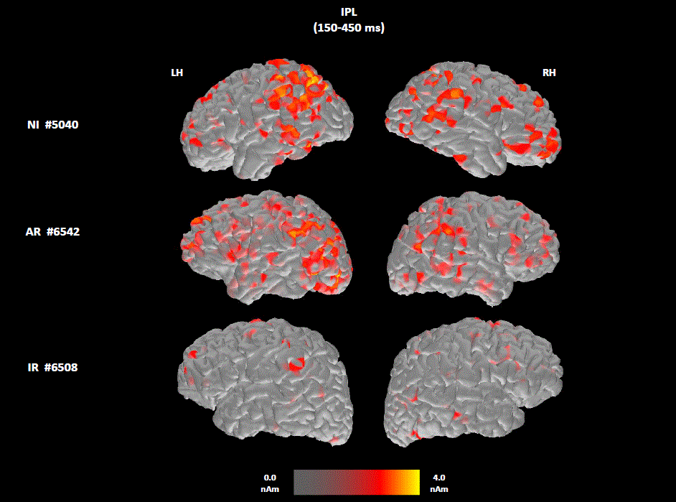
Baseline MEG Patterns for Adolescent Adequate and Inadequate Responders Rezaie et al., 2011
Notes:
Baseline brain activation maps from three representative participants: a non-impaired reader (NI; top row), a student who later showed adequate response to intervention (AR; middle row), and a student who did not show adequate response (IR; bottom row). When these recordings were made, this AR student scored 87 and 77 points on the TOWRE Sight Word and Pseudoword reading efficiency subtests, respectively (one year follow-up scores were 96 and 87 points). Corresponding scores for the IR student shown here, were 80/81 and 83/81 points. The relative intensity of activated voxels is shown at the bottom of the figure. Each set of images presents activity in inferior parietal (IPL) regions, comprised of the SMG/ANG, where significant group differences were observed, at 200-500 ms, in the left (LH) and right (RH) hemispheres.

Slide 37
Reliability of the Hybrid Method
If approach is to take a single assessment and set a cut point, identification of individual students will still be inadequately reliable
Attributes of LD (low achievement, inadequate instructional response) are dimensional (continua)
Difficult to assess people in relation to set cut point
May be improved if multiple criteria are used and confidence intervals
How many resources should be devoted to finding the right student? Treat, then test

Slide 38
Simulation of Agreement (10,000 Cases)
Consider WJIII Basic and TOWRE composite in Fletcher et al. (2011); r = .88 (.94 if corrected for unreliability). Set cut points at 25th %tile: agreement (k) = .76
If correlation = 1.0, k = 1.0
50th %tile, k = .77; 10th%, k = .71
If actual reliability (<.90), k =.76
Adjust for normative differences (sample mean above normative mean for WJ and below on TOWRE, k = .39
Sample size of 257, k = .27-.51

Slide 39
Actual Agreement
WJ-TOWRE: k =.38
WJ-CBM benchmark: k = .25
CBM benchmark-TOWRE: k = .61
Dual Discrepancy: k = .21 with WJ, .58 with CBM benchmark, .60 with TOWRE

Slide 40
Coverage
Consider 104 inadequate responders as pool to be detected. How many not detected by each indicator?
WJ: .72
TOWRE: .14
CBM benchmark: .30.
Dual Discrepancy: .11 (but increases pool to 134, adding 29 inadequate responders and 1 typical (i.e., higher achievers)

Slide 41
Multiple Criteria
CBM benchmark alone identified 14 children with reading scores on TOWRE, WJ, and other tests well above the average range (false positives?); this number increased dramatically with dual discrepancy
TOWRE and CBM benchmark agreed on 90/104 children, excluding those only identified by CBM or the 30 added by dual discrepancy (about 5’ of assessment time)
Think about a pool; use multiple assessments; prioritize Type II over Type I errors (i.e., set the cut point high).

Slide 42
Identification issues are universal across methods
No qualitative markers of LD (dimensional disorder
Measurement error (why do we persist with rigid cut points?
Instructional response may be a continuum; no qualitative markers of inadequate responders
Specific issues in RTI are more than cut points and don’t equate to the adequacy of the measurement of instructional response
How does the field move to informed decision making using multiple criteria and stop relying on psychometric methods?
Notes:
RTI methods also carry issues that have a specific impact on identification, including what constitutes inadequate instructional response, how to assess high-quality instruction, the amount of intervention needed to indicate intractability, and more research on the role of curriculum-based measures in the identification process (which measures at what grade levels for what domains and what cut points).

Slide 43
Can We “Psychometrize” Individual Identifications of LD? Not a New Question!
“Even though the psychometric difficulties may never be completely resolved, classification systems should at least be based on a coherent psychology of helping…there is no shortage of children who experience problems…Assessments and classifications can be guided by principles of intervention design with expected errors of judgment and measurement partially moderated through a recursive {sequential} system of recursive and empirical practices… (Macmann et al., 1988, p. 146)
“The real dilemma may be that procedures no more technically adequate than {formula-based procedures} are in wide use today. One wonders if a technically adequate solution to the problem of LD identification exists” (Danielson & Bauer, 1978, p. 175)

