Slide 1
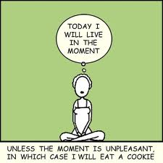
Using Mindfulness to Reduce Stress and Promote Well-being in Young People with Special Needs
Stefanie Goldstein, PhD
Elisha Goldstein, PhD

Slide 2
Overview
What is Mindfulness?
Mindfulness for Teens
How Can It Help Teens with Special Needs?
Focus
Emotion Regulation
Increased Emotional Intelligence
Impulse Control
Self-Compassion and Compassion

Slide 3
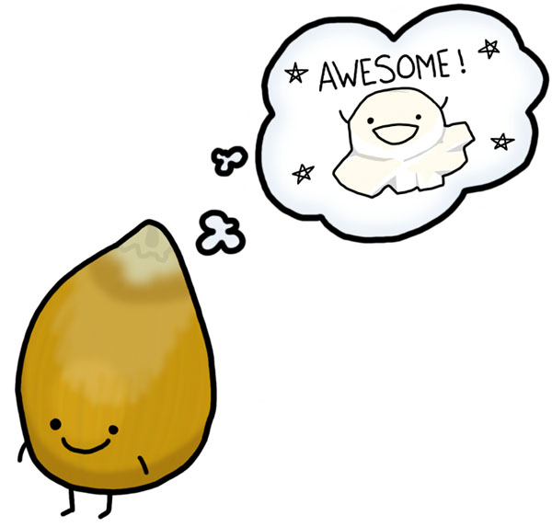
Wandering Mind Symbol
Notes:
POP INTO THE PRESENT MOMENT
Science - A Wandering Mind Is an Unhappy Mind (notice as your mind wanders during presentation)
Daniel Gilbert and Matthew Killingsworth out of harvard
46.9% wandering, except sex 10%
Wandering Mind – Default Mode
"A human mind is a wandering mind, and a wandering mind is an unhappy mind," Killingsworth and Gilbert write. "The ability to think about what is not happening is a cognitive achievement that comes at an emotional cost."

Slide 4
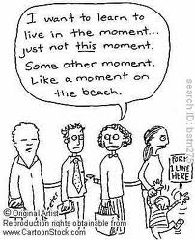
What is Mindfulness?

Slide 5
Mindful Qualities
Presence
Non-judgment
Empathy
Self-attunement, Self-compassion, & Compassion
Emotion regulation – salt in a glass/lake
Learning to be okay with uncertainty
Increased Focus

Slide 6
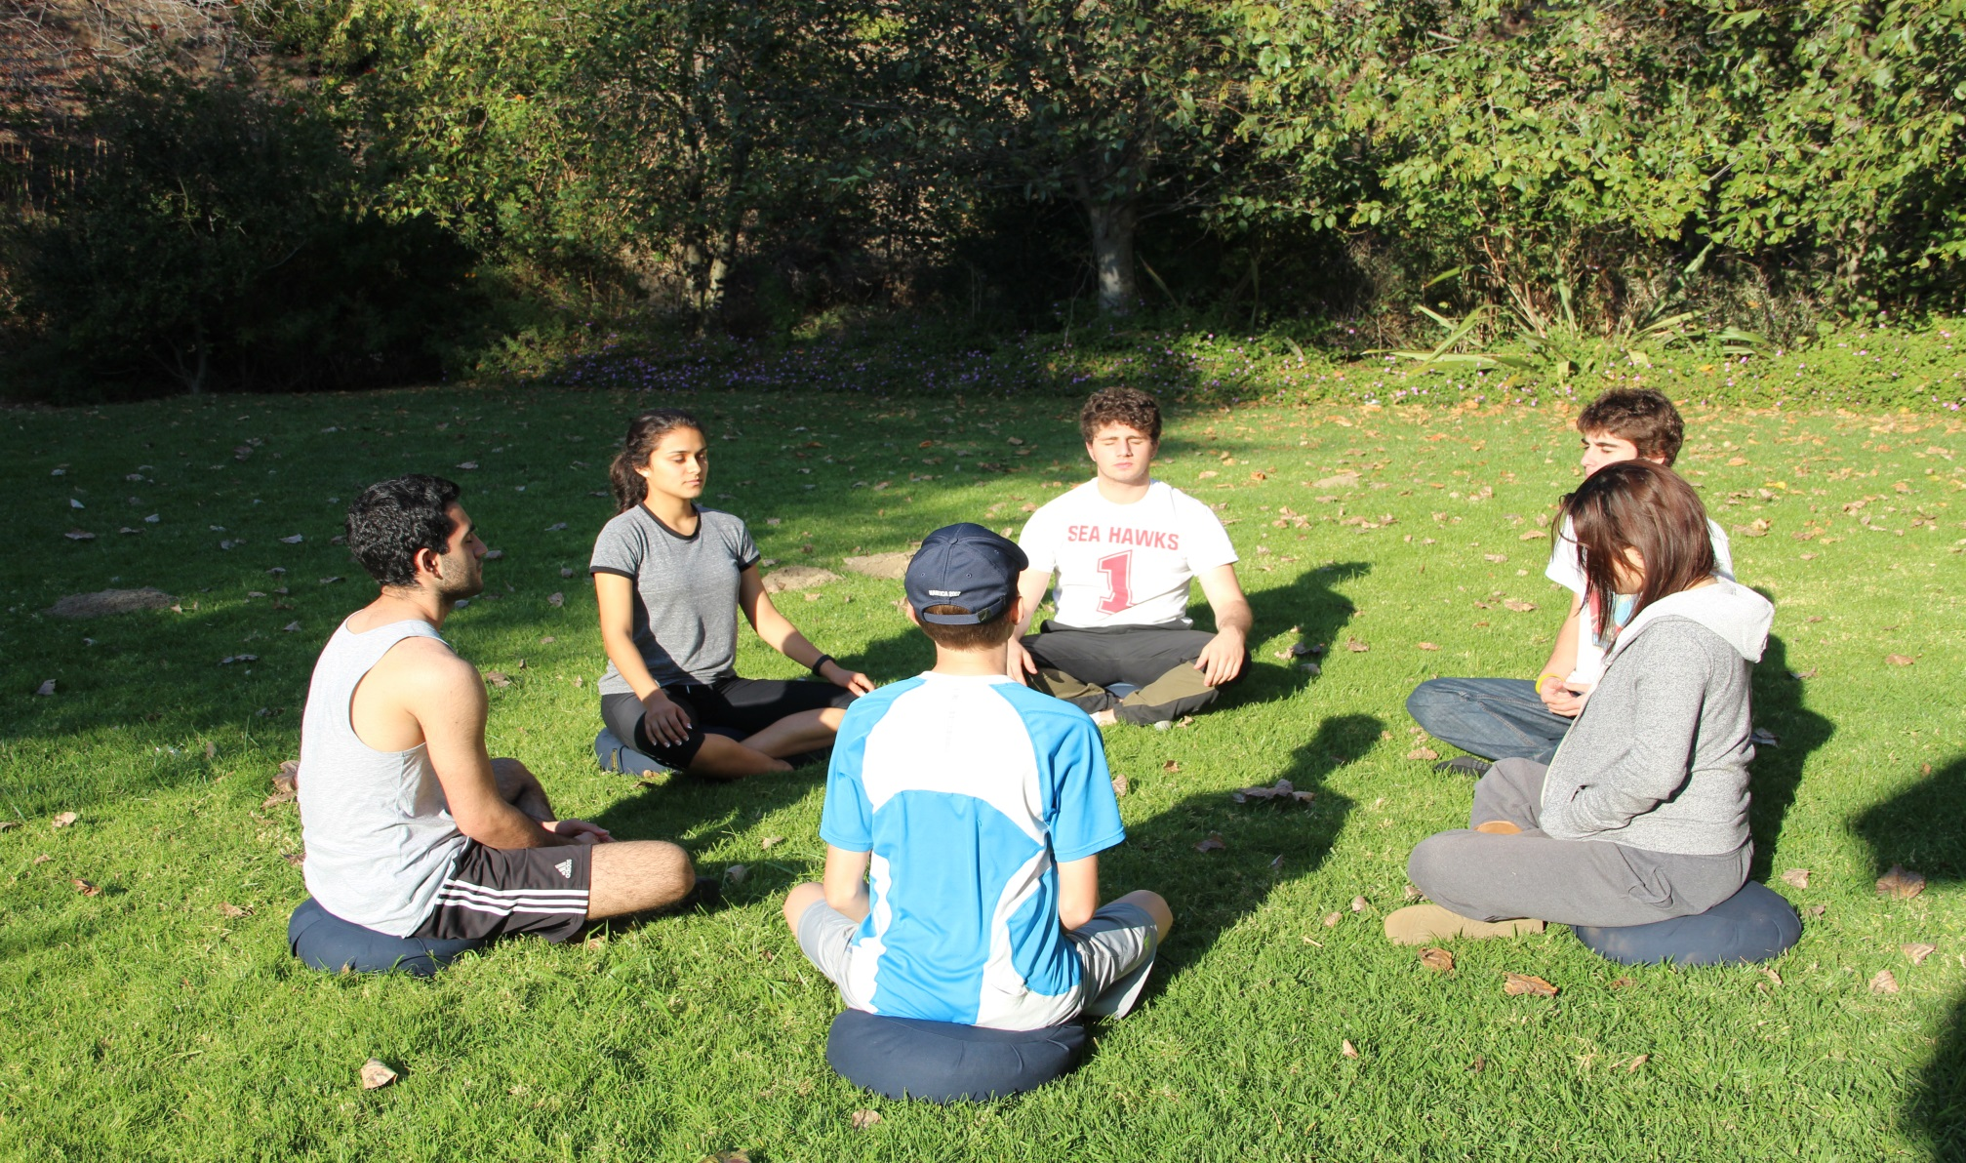
Mindfulness for Teens

Slide 7
CALM Practices
Body Scan Meditation: Scan of entire body
Mindful Movement: mindful awareness of the body during yoga
Sitting Meditation: mindfulness of breath, body, feelings, thoughts, and emotions
Walking Meditation: mindfulness in action
Loving-kindness/Compassion Practices
Music Meditation
Daily Home Practice: up to 15 minutes meditation and daily informal practice

Slide 8
In Their Own Words:
“From this class I learned about mindfulness, how to communicate better, how to manage stress, and how to be more compassionate with myself and others.” -Anna,17
“I was very amazed and happy at the effects mindfulness has had on my panic, focus, and mood.” -Paula,16
“Mindfulness for me, has become a practice in my life that helps me to have some perspective over my feelings instead of being lost in the middle of it all. It makes feelings less confusing.” -Lana,17
“From this class I think I’ll carry with me the idea that stepping back and being mindful can really help in dealing with conflicts that might arise.” -Ethan, age 16
“I learned that even though I may not be in complete control of what happens around me I can come to an awareness of my environment to better the way situations are approached.” -Maria, age 17
“I learned just how deeply I was masking my emotions.” -Joshua, age 17
“I learned that I need to stop holding onto to life really vigorously and just let life run its course. I was surprised that I was actually able to come to this conclusion and somewhat achieve it.” -Gabriel, age 16

Slide 9
Mindfulness for Teens with Special Needs
Notes:
Need to take cognitive Level into consideration and adjust accordingly, making the meditations and exercises playful and engaging, shorter, bite sized practices

Slide 10
Things to Keep in Mind
Take the teens cognitive level into consideration and adjust accordingly
Make the meditations and exercises playful, engaging and creative - shorter, bite sized practices
Manage expectations (yours and theirs).
Notes:
Not a cure all – not a panacea, another tool in your tool box – we always say, go with what works – going to be different for everyone. Take your child or the child you are working with into consideration in chosing what might work best for them.

Slide 11
How can Mindfulness Help Youth with Special Needs?
Emotion Regulation
Focus
Increased awareness of one’s thoughts, sensations and emotions
Impulse control
Increased compassion and self-compassion

Slide 12
Emotion Regulation

Slide 13
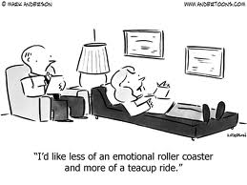

Slide 14
Flipping Your Lid

Slide 15
“Putting Feelings into Words”
Jane Dick

Slide 16
“Putting Feelings into Words”
Fear Anger

Slide 17
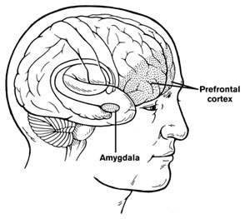
“Putting Feelings into Words” Research Study Results
Putting Feelings Into Words: Affect Labeling Disrupts Amygdala Activity in Response to Affective Stimuli” Psychological Science, pp. 421-428.
Notes:
Tell Story of Jack Kent and his dragon, There’s no such thing as dragons.
Mindfulness helps us gently and compassionately acknowledge our fears and pain.

Slide 18
Autism and Mindfulness: Finding the Rhythm
"Meditation is one of a few interventions that have been shown to effectively strengthen self control and character development simultaneously.”
~ Sequeira, S and Ahmed, M. (2012). Meditation as a Potential Therapy for Autism
Problem: Environment overwhelms the inner world = Short Circuit/Shut down
Solution: Mindfulness and Meditation can help to override impaired brain synchronicity/integration by restoring rhythm and safety
Examples: Focusing on the breath, mantra, rubbing hands, mindfulness of music
Sequeira, S and Ahmed, M. (2012). Meditation as a Potential Therapy for Autism: A Review. Autism Research and Treatment. Volume 2012, Article ID 835847. http://dx.doi.org/10.1155/2012/835847

Slide 19
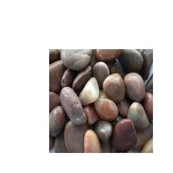
BJ’s Story: The Rock
Notes:
Read story of MBCT person
"Depression struck me at 13, then 16, and has ruined the quality of my life on and off for forty years. It's been a murky maze of underground thoughts and feelings that attacked me internally like viruses. I used to feel like a sitting duck when depression hit and felt hopeless and helpless. I would usually shut down, hide out, and in the early days drink or smoke. Anything to become numb or not to feel the painful combination of feelings -- the self-loathing, the powerlessness, the despair. With this work I gained a sense of confidence.
When I felt depression coming on I snapped into gear and brought out my arsenal of goodies, in much the same way when I thought I was getting a cold I got out the echincea, the vitamin C, and the tea. If depression hits it is easier to get rid of.
First of all, the body scan. A godsend for getting out of my head when thoughts are recurring and rattling painfully around. Worried at 3 a.m. about my pregnant daughter having a miscarriage since she's already had two -- can't stop the images I'm seeing -- so focus on my left toe instead or my right knee. This moves the area of concentration to something not upsetting or disconcerting-to something in the present moment -- to something I can handle. Concentrate on body parts enough and I come back into the present time.
I teach high school and the teenagers are often angry and depressed. They act out repeatedly and will frequently curse me out in the middle of class. Frequently, it makes me angry and I hurl a sarcastic remark at them which only makes them angrier. Now I stop and do the 3 minute meditation -- breathe -- become aware of what I feel -- reset my button (which they've pushed) and act and respond from the place of a semblance of composure and balance.
Another tool to ward off depression, which makes everything crowded and pinched inside, is to do yoga, which creates space and well-being. From that state of mind I make better choices.
When in the past I slipped into negative self-speak, hurling slogans at myself that I've internalized over the years, now I remember I don't have to "believe everything I think." I consider that maybe what I am telling myself is merely conditioned thinking.
This has all brought me to the point of being aware of what is happenings as it is happening. With awareness or mindfulness things don't get out of hand and I am able to make better choices in the moment, (even if the choice is just a different thought) and therefore the depression is averted because the usual chain reaction is interrupted or if it hits I experience a more mild depression.
For the first time I feel I can prevent deep depression from assaulting me but if it does I feel I can work out of it sooner. Depression thrives on conditioning, panic and darkness. It is a drowning in quicksand.
With meditation I can loosen conditioned thoughts and feel more centered with my feet on the ground. Insight provides a light to see by and I am not swallowed up by the demons and forces of darkness. This class has enabled me to do that. Really."

Slide 20
Mindfulness for Teens: The STOP Practice

Slide 21
Discussion
What did you notice?
How is this relevant to teens?
How is this relevant to you?

Slide 22
AWARENESS

Slide 23
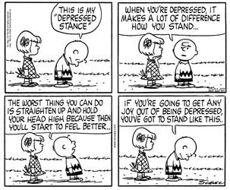

Slide 24
What is the #1 Way
Humans Avoid Discomfort?
Thinking
Notes:
Thinking is the biggest dis-ease of our time - #1 way to avoid
Future Tripping, Fixing

Slide 25
Working with Thoughts: Thoughts are Not Facts

Slide 26
Reducing Trigger of Rumination (aka Craving)
Mindfulness Reduces Self-Referencing
/Rumination in Brain:
Mindfulness Vs. Control
Result - more right lateral recruitment
in somatosensory areas (experiential) and
reduced activity in the cortical midline (narrative focus)
= decreased depression scores.
Farb, N.A., Anderson, A.K., Mayberg, H., Bean, J., McKeon, D., Segal, Z.V., 2010.
Minding one's emotions: mindfulness training alters the neural expression of
sadness. Emotion 10, 25–33
Notes:
Narrative – Story
Rumination - Weave example of thoughts, ruminations, emotions, sensations

Slide 27
Anna’s Story: The Teachings of a Leaf

Slide 28
Notes:
Science - A Wandering Mind Is an Unhappy Mind (notice as your mind wanders during presentation)
Daniel Gilbert and Matthew Killingsworth out of harvard
46.9% wandering, except sex 10%
Wandering Mind – Default Mode
"A human mind is a wandering mind, and a wandering mind is an unhappy mind," Killingsworth and Gilbert write. "The ability to think about what is not happening is a cognitive achievement that comes at an emotional cost."

Slide 29
Impulse Control

Slide 30
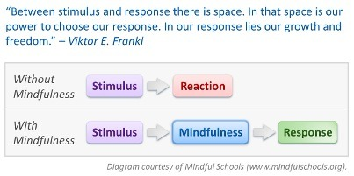
Helps to slow everything down (heart rate, breath, thoughts) and get the person more connected and grounded in their body.
Helps to create a “pause” between stimulus and response, so one can turn a Reaction → Response.

Slide 31
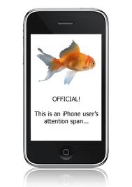
Sophie's Story: Finding Her Inner Calm
Notes:
Read story of MBCT person
"Depression struck me at 13, then 16, and has ruined the quality of my life on and off for forty years. It's been a murky maze of underground thoughts and feelings that attacked me internally like viruses. I used to feel like a sitting duck when depression hit and felt hopeless and helpless. I would usually shut down, hide out, and in the early days drink or smoke. Anything to become numb or not to feel the painful combination of feelings -- the self-loathing, the powerlessness, the despair. With this work I gained a sense of confidence.
When I felt depression coming on I snapped into gear and brought out my arsenal of goodies, in much the same way when I thought I was getting a cold I got out the echincea, the vitamin C, and the tea. If depression hits it is easier to get rid of.
First of all, the body scan. A godsend for getting out of my head when thoughts are recurring and rattling painfully around. Worried at 3 a.m. about my pregnant daughter having a miscarriage since she's already had two -- can't stop the images I'm seeing -- so focus on my left toe instead or my right knee. This moves the area of concentration to something not upsetting or disconcerting-to something in the present moment -- to something I can handle. Concentrate on body parts enough and I come back into the present time.
I teach high school and the teenagers are often angry and depressed. They act out repeatedly and will frequently curse me out in the middle of class. Frequently, it makes me angry and I hurl a sarcastic remark at them which only makes them angrier. Now I stop and do the 3 minute meditation -- breathe -- become aware of what I feel -- reset my button (which they've pushed) and act and respond from the place of a semblance of composure and balance.
Another tool to ward off depression, which makes everything crowded and pinched inside, is to do yoga, which creates space and well-being. From that state of mind I make better choices.
When in the past I slipped into negative self-speak, hurling slogans at myself that I've internalized over the years, now I remember I don't have to "believe everything I think." I consider that maybe what I am telling myself is merely conditioned thinking.
This has all brought me to the point of being aware of what is happenings as it is happening. With awareness or mindfulness things don't get out of hand and I am able to make better choices in the moment, (even if the choice is just a different thought) and therefore the depression is averted because the usual chain reaction is interrupted or if it hits I experience a more mild depression.
For the first time I feel I can prevent deep depression from assaulting me but if it does I feel I can work out of it sooner. Depression thrives on conditioning, panic and darkness. It is a drowning in quicksand.
With meditation I can loosen conditioned thoughts and feel more centered with my feet on the ground. Insight provides a light to see by and I am not swallowed up by the demons and forces of darkness. This class has enabled me to do that. Really."

Slide 32
Mindful Schools Study
400 kids – 5 weeks, 3X/week - Student behavior improved significantly in all four areas measured—paying attention, self-control, classroom participation, and respect for others—and these gains were maintained seven weeks later.
UK Study
500 kids, in 12 schools, age 12-16. Half got 9 week Mindfulness class and half didn’t. All students were followed up after a three month period which was timed to coincide with the summer exam period (a time of high stress).
The researchers found that those children who participated in the mindfulness program reported fewer depressive symptoms, lower stress and greater wellbeing than those in the control group.
Kuyken, W., et al. (2013). Effectiveness of the Mindfulness in Schools Programme: Non-randomised controlled feasibility study. British Journal of Psychiatry.
Black, D. S. & Fernando, R. (2013). Mindfulness training and classroom behavior among lower-income and ethnic minority elementary school children. Journal of Child and Family Studies.

Slide 33
FOCUS

Slide 34
ADHD and Mindfulness
A 2011 study published in the Journal of Child and Family Studies demonstrated the effectiveness of an eight-week mindfulness program for children ages 8-12 with ADHD, along with a mindful parenting program for their parents. The researchers found that the program reduced parent-reported ADHD behavior. It also increased mindful awareness among both parents and children, and reduced parental stress.
“There are no long-term, lasting benefits from taking A.D.H.D. medications,” James M. Swanson, a psychologist at the University of California, Irvine, told the New York Times. “But mindfulness seems to be training the same areas of the brain that have reduced activity in A.D.H.D... “That’s why mindfulness might be so important. It seems to get at the causes.”

Slide 35
Maddy’s Story
Notes:
Madeline’s story on how because of her ADHD taking tests were the bain of her existence and always made her cry but after taking our class and practicing the body scan she was actually able to complete a test without crying which is something she never thought possible

Slide 36
Notes:
Science - A Wandering Mind Is an Unhappy Mind (notice as your mind wanders during presentation)
Daniel Gilbert and Matthew Killingsworth out of harvard
46.9% wandering, except sex 10%
Wandering Mind – Default Mode
"A human mind is a wandering mind, and a wandering mind is an unhappy mind," Killingsworth and Gilbert write. "The ability to think about what is not happening is a cognitive achievement that comes at an emotional cost."

Slide 37
Compassion and Self-Compassion

Slide 38
Hally’s Story: May I be Happy?
Notes:
Read story of MBCT person
"Depression struck me at 13, then 16, and has ruined the quality of my life on and off for forty years. It's been a murky maze of underground thoughts and feelings that attacked me internally like viruses. I used to feel like a sitting duck when depression hit and felt hopeless and helpless. I would usually shut down, hide out, and in the early days drink or smoke. Anything to become numb or not to feel the painful combination of feelings -- the self-loathing, the powerlessness, the despair. With this work I gained a sense of confidence.
When I felt depression coming on I snapped into gear and brought out my arsenal of goodies, in much the same way when I thought I was getting a cold I got out the echincea, the vitamin C, and the tea. If depression hits it is easier to get rid of.
First of all, the body scan. A godsend for getting out of my head when thoughts are recurring and rattling painfully around. Worried at 3 a.m. about my pregnant daughter having a miscarriage since she's already had two -- can't stop the images I'm seeing -- so focus on my left toe instead or my right knee. This moves the area of concentration to something not upsetting or disconcerting-to something in the present moment -- to something I can handle. Concentrate on body parts enough and I come back into the present time.
I teach high school and the teenagers are often angry and depressed. They act out repeatedly and will frequently curse me out in the middle of class. Frequently, it makes me angry and I hurl a sarcastic remark at them which only makes them angrier. Now I stop and do the 3 minute meditation -- breathe -- become aware of what I feel -- reset my button (which they've pushed) and act and respond from the place of a semblance of composure and balance.
Another tool to ward off depression, which makes everything crowded and pinched inside, is to do yoga, which creates space and well-being. From that state of mind I make better choices.
When in the past I slipped into negative self-speak, hurling slogans at myself that I've internalized over the years, now I remember I don't have to "believe everything I think." I consider that maybe what I am telling myself is merely conditioned thinking.
This has all brought me to the point of being aware of what is happenings as it is happening. With awareness or mindfulness things don't get out of hand and I am able to make better choices in the moment, (even if the choice is just a different thought) and therefore the depression is averted because the usual chain reaction is interrupted or if it hits I experience a more mild depression.
For the first time I feel I can prevent deep depression from assaulting me but if it does I feel I can work out of it sooner. Depression thrives on conditioning, panic and darkness. It is a drowning in quicksand.
With meditation I can loosen conditioned thoughts and feel more centered with my feet on the ground. Insight provides a light to see by and I am not swallowed up by the demons and forces of darkness. This class has enabled me to do that. Really."

Slide 39
Self-Compassion Practice
Notes:
Read story of MBCT person
"Depression struck me at 13, then 16, and has ruined the quality of my life on and off for forty years. It's been a murky maze of underground thoughts and feelings that attacked me internally like viruses. I used to feel like a sitting duck when depression hit and felt hopeless and helpless. I would usually shut down, hide out, and in the early days drink or smoke. Anything to become numb or not to feel the painful combination of feelings -- the self-loathing, the powerlessness, the despair. With this work I gained a sense of confidence.
When I felt depression coming on I snapped into gear and brought out my arsenal of goodies, in much the same way when I thought I was getting a cold I got out the echincea, the vitamin C, and the tea. If depression hits it is easier to get rid of.
First of all, the body scan. A godsend for getting out of my head when thoughts are recurring and rattling painfully around. Worried at 3 a.m. about my pregnant daughter having a miscarriage since she's already had two -- can't stop the images I'm seeing -- so focus on my left toe instead or my right knee. This moves the area of concentration to something not upsetting or disconcerting-to something in the present moment -- to something I can handle. Concentrate on body parts enough and I come back into the present time.
I teach high school and the teenagers are often angry and depressed. They act out repeatedly and will frequently curse me out in the middle of class. Frequently, it makes me angry and I hurl a sarcastic remark at them which only makes them angrier. Now I stop and do the 3 minute meditation -- breathe -- become aware of what I feel -- reset my button (which they've pushed) and act and respond from the place of a semblance of composure and balance.
Another tool to ward off depression, which makes everything crowded and pinched inside, is to do yoga, which creates space and well-being. From that state of mind I make better choices.
When in the past I slipped into negative self-speak, hurling slogans at myself that I've internalized over the years, now I remember I don't have to "believe everything I think." I consider that maybe what I am telling myself is merely conditioned thinking.
This has all brought me to the point of being aware of what is happenings as it is happening. With awareness or mindfulness things don't get out of hand and I am able to make better choices in the moment, (even if the choice is just a different thought) and therefore the depression is averted because the usual chain reaction is interrupted or if it hits I experience a more mild depression.
For the first time I feel I can prevent deep depression from assaulting me but if it does I feel I can work out of it sooner. Depression thrives on conditioning, panic and darkness. It is a drowning in quicksand.
With meditation I can loosen conditioned thoughts and feel more centered with my feet on the ground. Insight provides a light to see by and I am not swallowed up by the demons and forces of darkness. This class has enabled me to do that. Really."

Slide 40
What is the Secret?
How Did the rose Ever open its heart And give to this world All its Beauty? It felt the encouragement of light Against its Being, Otherwise, We all remain Too Frightened.
from "The Gift" (poems by Hafiz)

Slide 41
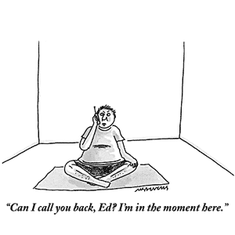

Slide 42
Go Forth and Be Mindful…
Stefanie Goldstein, PhD
www.stefaniegoldsteinphd.com
stefanie@stefaniegoldsteinphd.com
Elisha Goldstein, PhD
www.elishagoldstein.com
Twitter: Mindful_Living
Facebook: Elisha Goldstein

